Slide 1
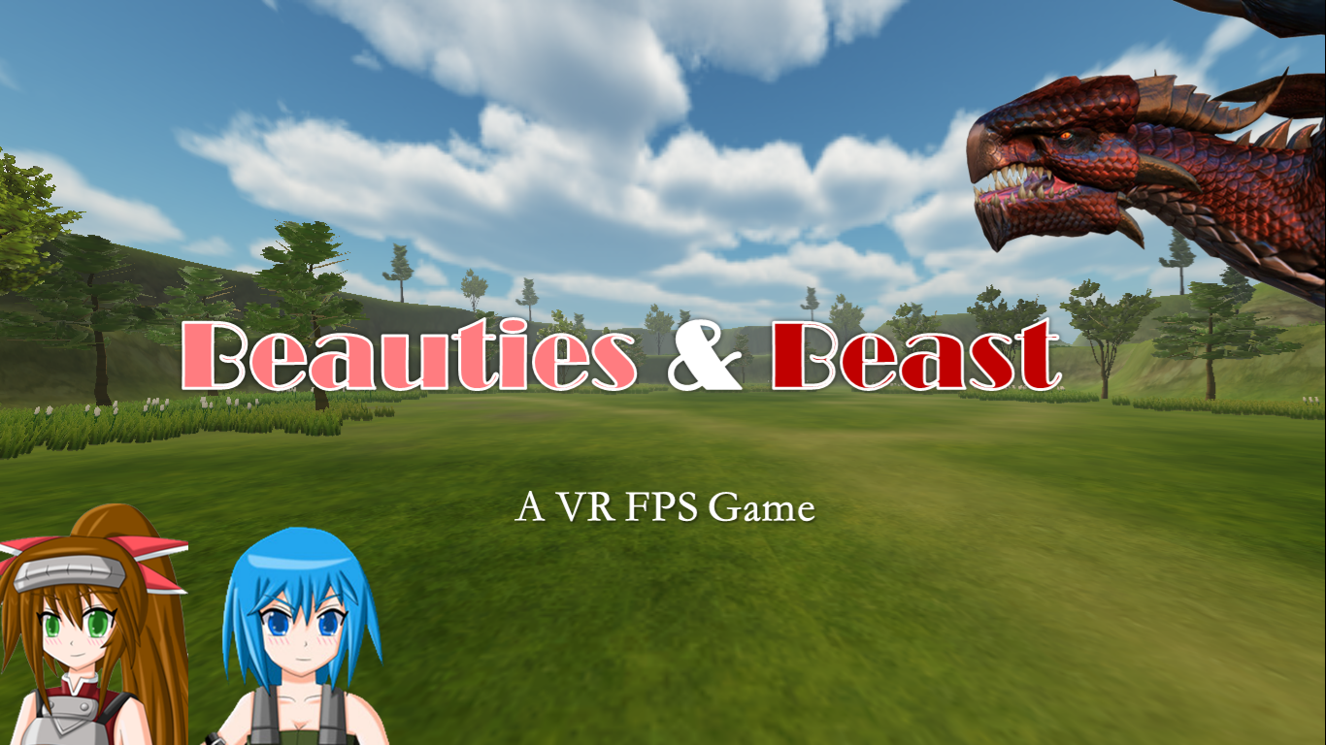
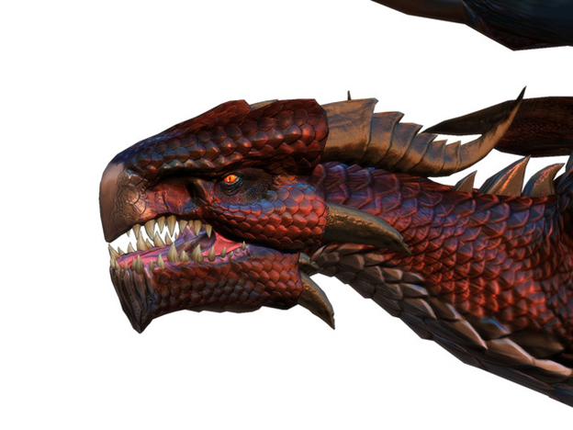


Beauties and Beast
A VR FPS Game

Slide 2
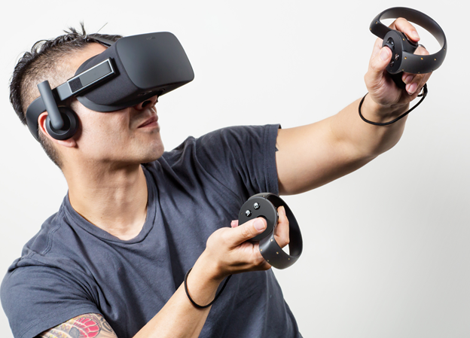

Devices & Game Engine
Beauties and Beast is a first person VR shooting game developed with Oculus Rift.
The game was developed using Unity.

Slide 3
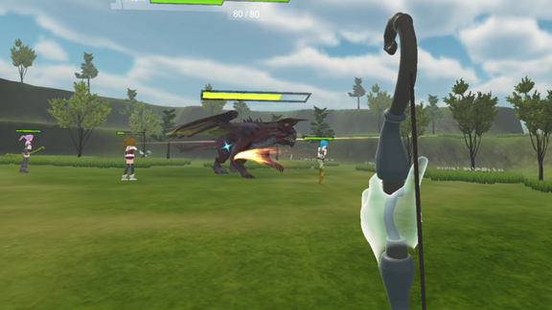
Game Rule
In the game player fights against an evil dragon with three beautiful girls.
To win the game the player needs to beat the evil dragon. However if player dies (health point gets reduced to 0) before beating the evil dragon, player loses the game.

Slide 4
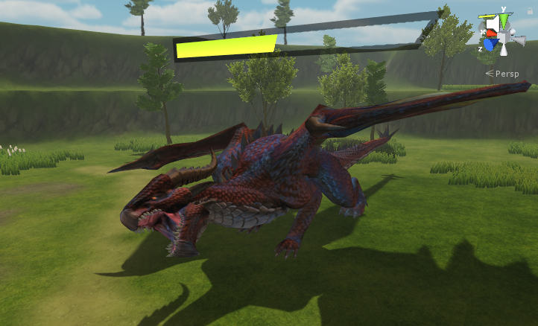
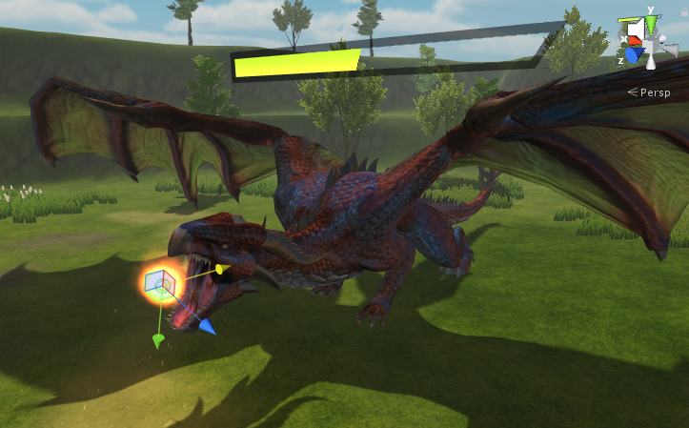
Evil Dragon
The evil dragon has two attack modes - melee attack and ranged fireball.

Slide 5
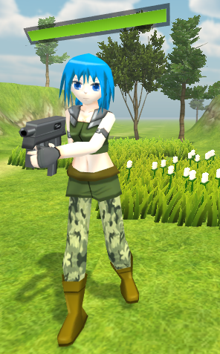
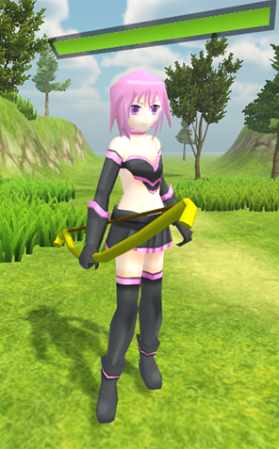
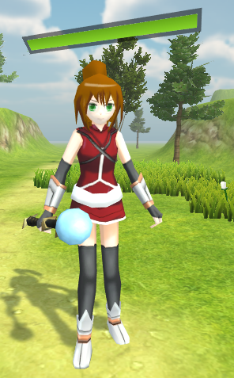
Three Beauties
The three beauties fighting with you are a gunman, a bowman, and a magician respectively.

Slide 6
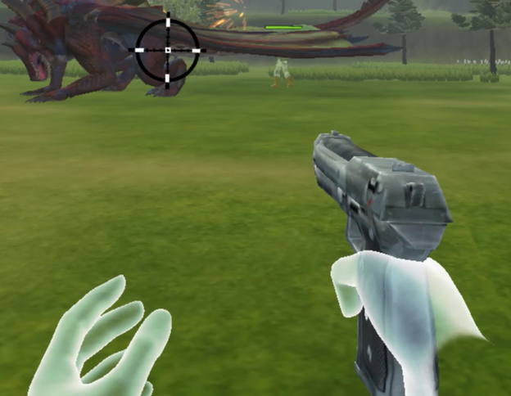
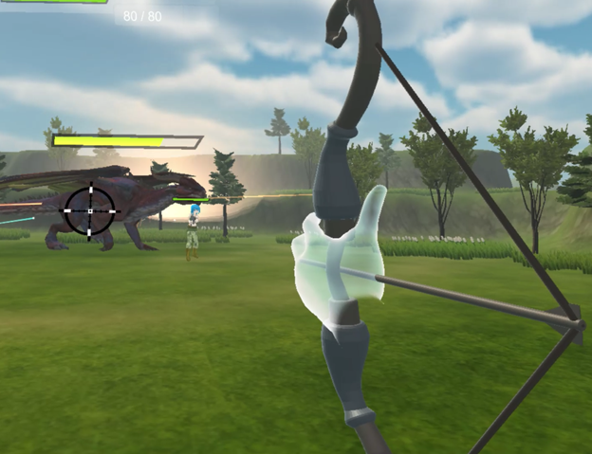
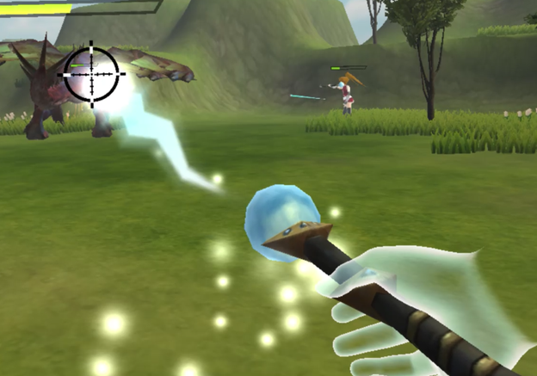
Multiple Weapons
Player can choose among multiple long-range weapons and switch between them in the game.

Slide 7
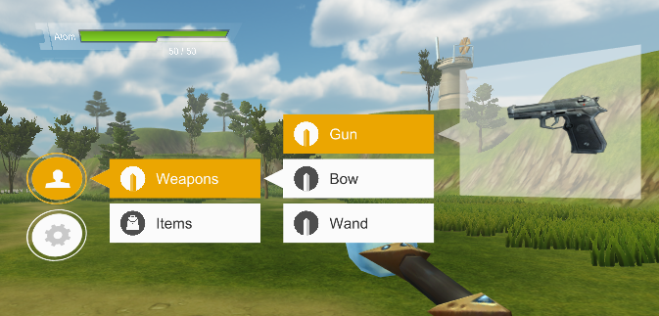
In-Game Menu UI
Player can change weapon and quit the game in the menu. Calling up the menu wouldn’t pause the game which can bring player a sense of tension.

Slide 8
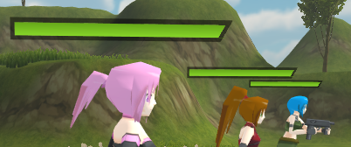

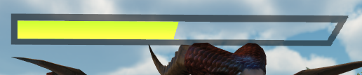
HP Bars UI
Beauties HP Bars
Player HP Bar
Dragon HP Bar

Slide 9

Demo Video

Slide 10
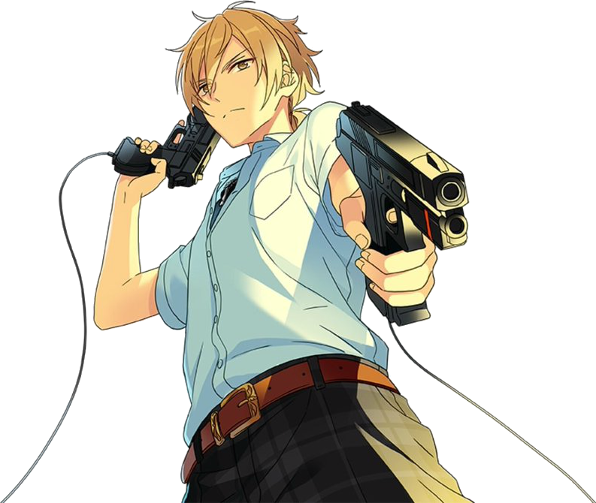
Benefits
Marksmanship
Attention
Hand-Eye Coordination
Entertainment

Slide 11
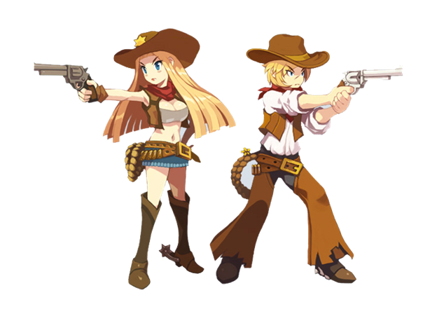
Possible Improvements
More Weapons (sword, shield, grenade...)
Multiplayer
Improved Scenes
Reward System

Slide 12

Thank you for your listening!

